Slide 1
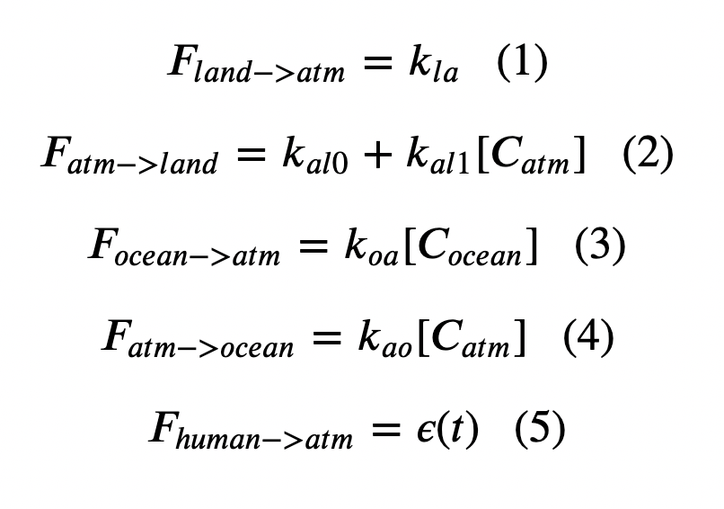
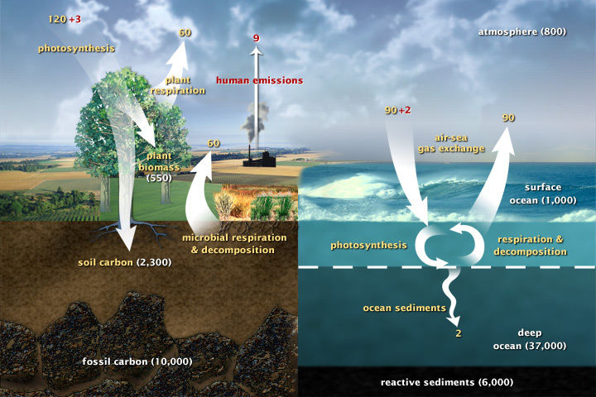
Cambio 1.0 fluxes (we introduced this in Week 3)
We’re assuming a constant non-anthropogenic land-to-atmosphere flux

Slide 2
Cambio 1.0 fluxes
This models $CO_{2}$ fertilization

Slide 3
Cambio 1.0 fluxes
The more concentrated $CO_{2}$ is in the water, the faster it will come out!

Slide 4
Cambio 1.0 fluxes
The more concentrated $CO_{2}$ is in the air, the faster it will go into the ocean!

Slide 5
Cambio 1.0 fluxes
There’s ScheduledFlows and ScheduledFlowsLTE

Slide 6
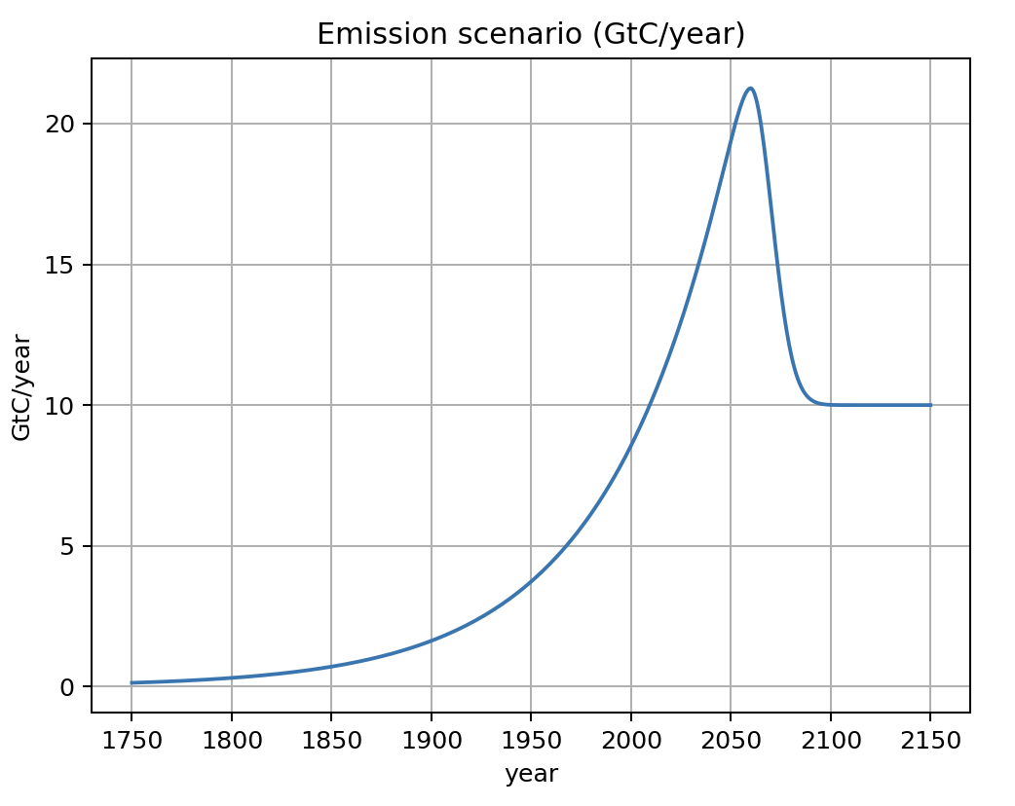
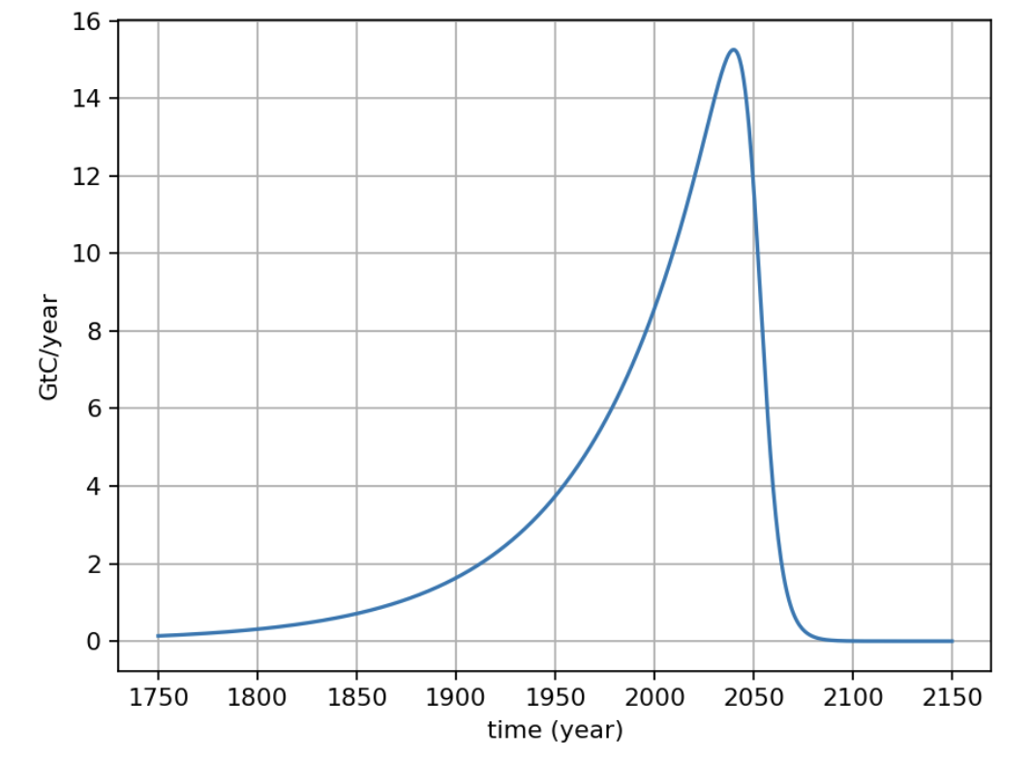
ScheduledFlowsLTE is ScheduledFlows with long-term emissions
ScheduledFlows
(Week 5)
ScheduledFlowsLTE
(Week 6)

Slide 7
Cambio 1.0 puts those fluxes into an Euler loop
Inside an Euler loop (like the loop you made in Week 2, SimpleRadiativeBalance):

Slide 8
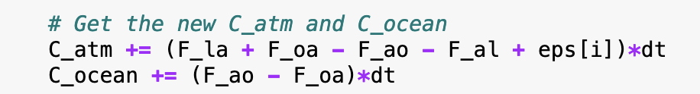
Cambio 1.0 puts those fluxes into an Euler loop
Inside an Euler loop (like the loop you made in Week 2, SimpleRadiativeBalance):

Slide 9
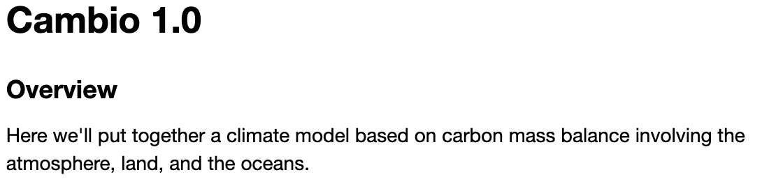
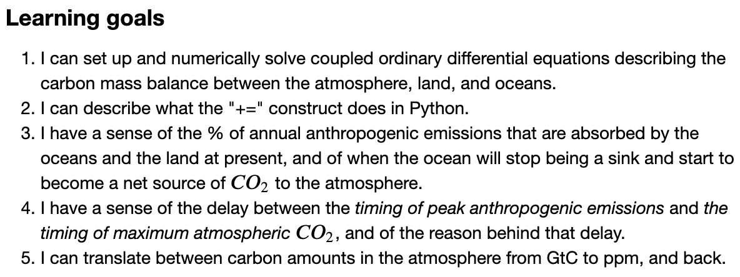
OK, let’s get started!

